Slide 1
JUKEBOX
A place where you can refresh your mood.

Slide 2

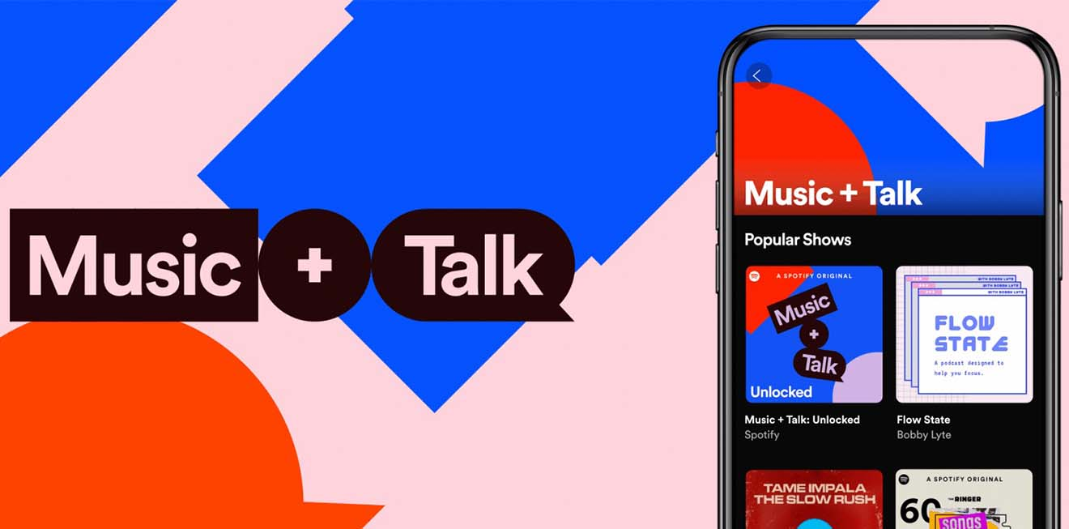
PROBLEM STATEMENT :
Designing a modern jukebox that contains songs by various artists and podcasts
by celebrities.
Songs should be categorised based on album, artist, genre .
Podcasts are displayed at homepage. Should show live stream music of various artists.
Users can create multiple playlists.
Displays all songs in Tabular format.

Slide 3
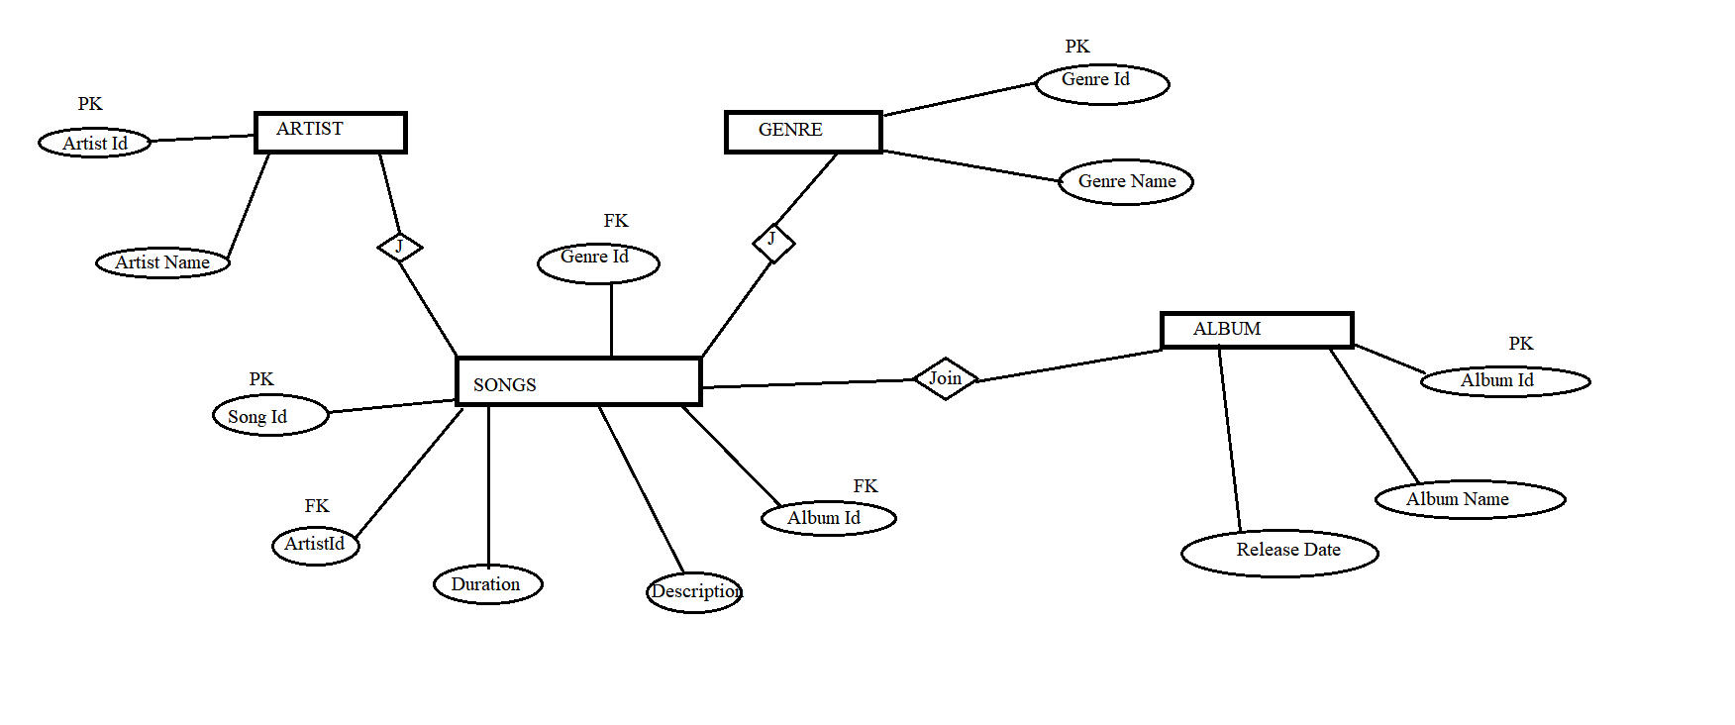
ER – DIAGRAMS.
Songs , Genre and Album Tables

Slide 4
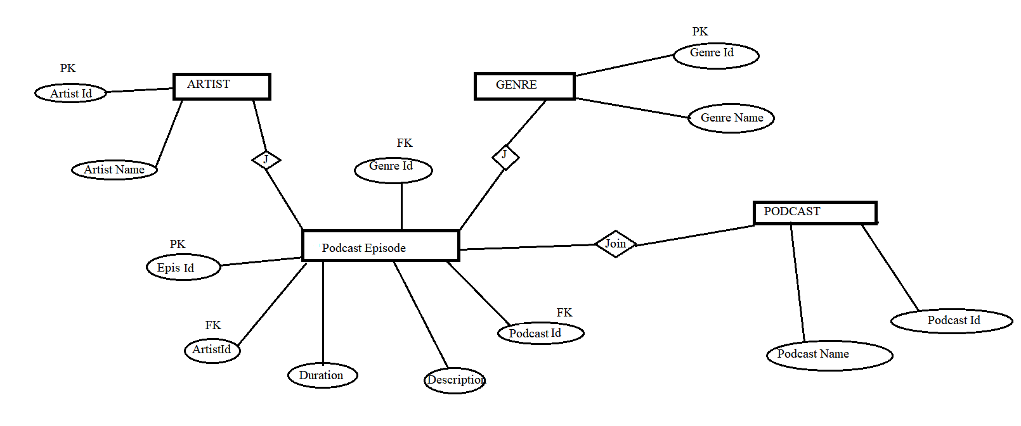
ER-DIAGRAM
Genre, Artist, Podcast, Podcast Episode table

Slide 5
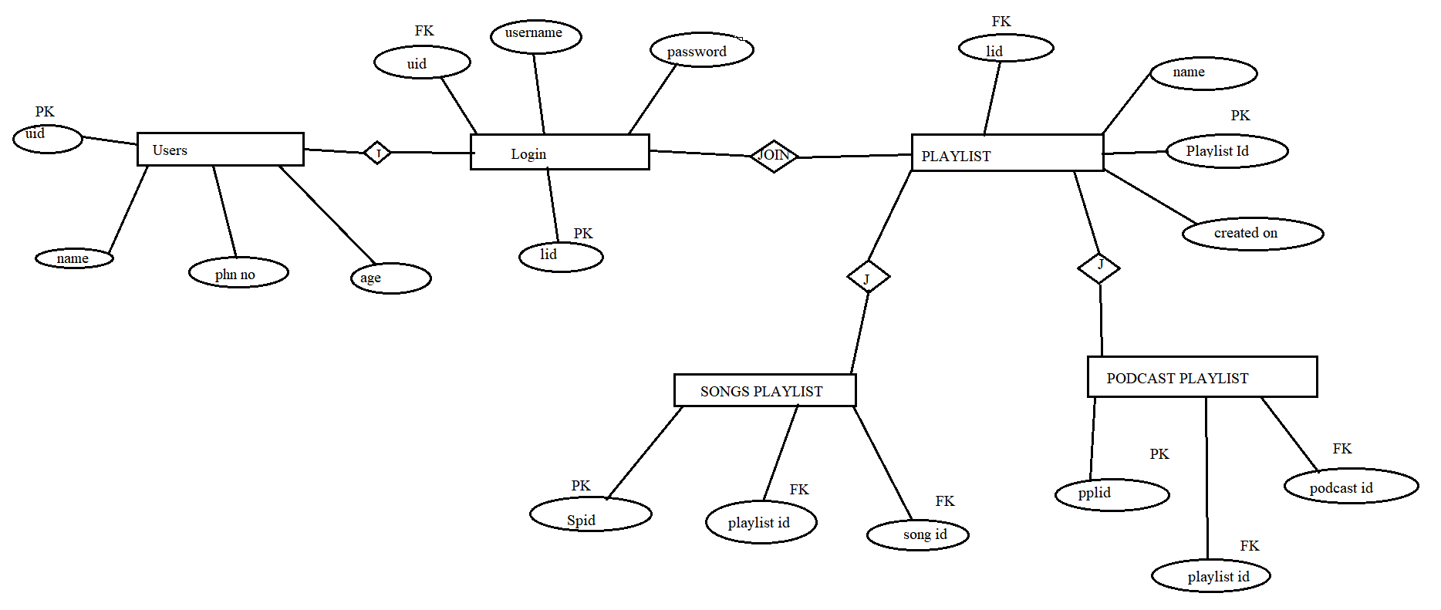
ER – DIAGRAM
Login, User, Playlist, Songs Playlist, Podcast Playlist

Slide 6
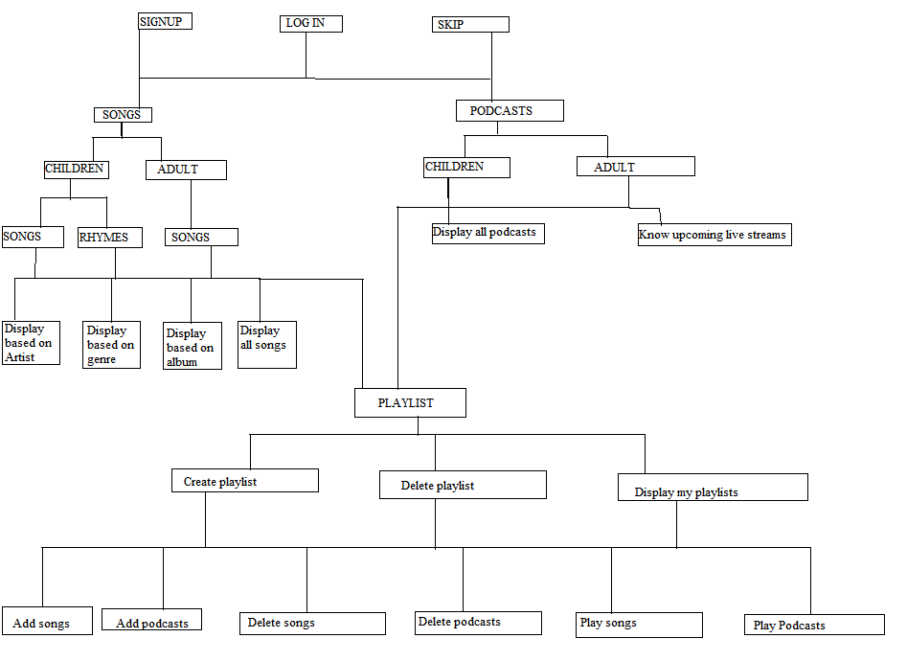
BASIC FLOW CHART

Slide 7
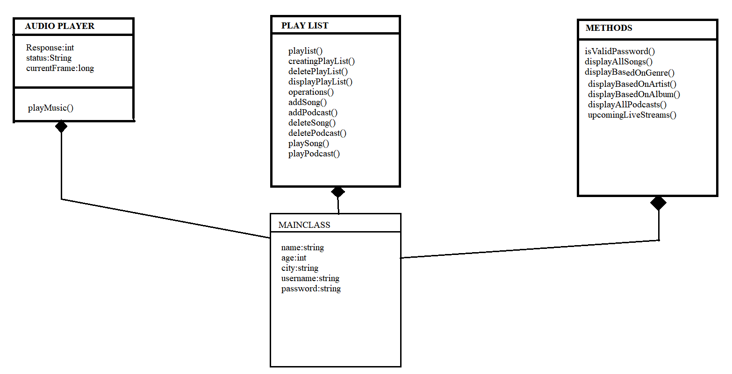
CLASS DIAGRAM

Slide 8
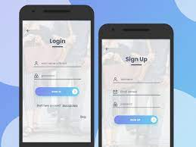
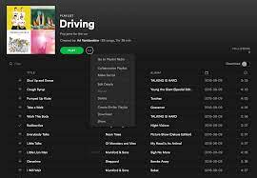
INTRODUCTION
JukeBox Consists of Songs and podcasts.
Application is developed for both children and Adults.
Without Login/Signup user can access application ,But cannot listen the songs.
User can create playlists of his/her own.
One user can have multiple playlists.

Slide 9


SONGS
It is classified into 2 types
Children.
Children Songs.
Children Rhymes.
Adults.
Every module has some basic operations like
Display all Songs
Display Based on Album.
Display Based on Artists.
Display Based on Genre.
Playlist
Children enjoy learning through jukebox.

Slide 10

PODCASTS
Podcasts are classified into 2 types
Child podcast.
Adult Podcast.
Playlist.
Podcast helps in relaxing and refreshing mood.

Slide 11

PLAYLIST.
User can create his own playlists.
One user can have multiple playlist based on his/her mood and occasion.
Single playlist can have both songs and podcasts.
User can add unlimited number of songs to his playlists.

Slide 12


